Slide 1
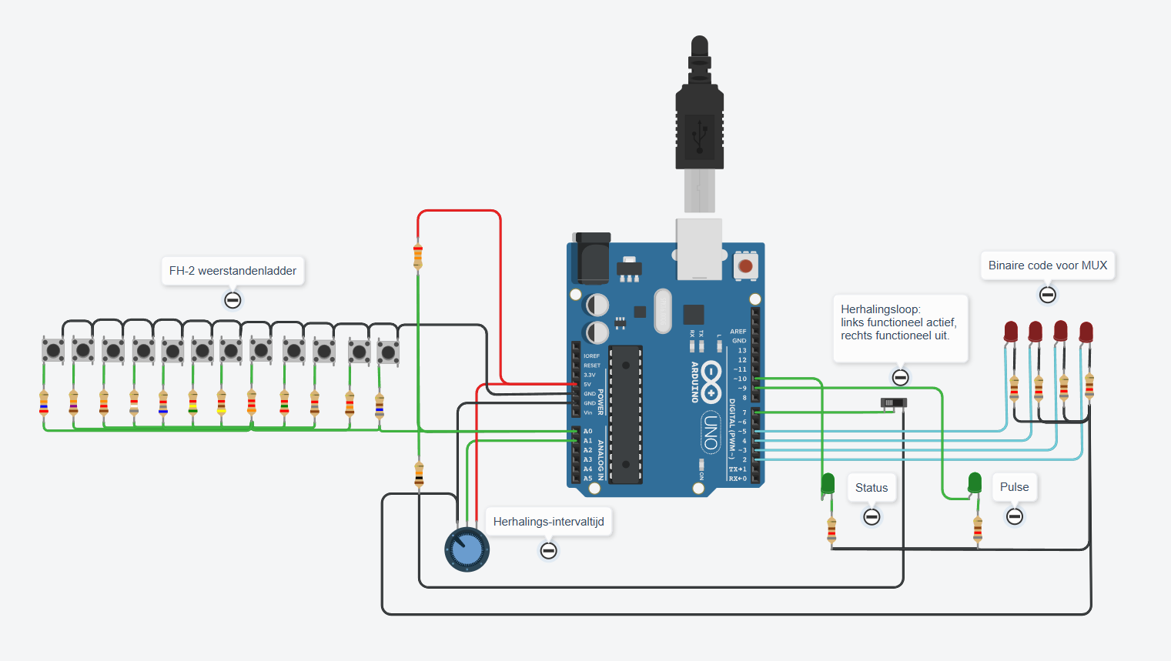
Arduino NANO 991
Resistor ladder
MUX code
Repeat Switch:
Left: active
VCC
D8
D7
GND
A0
D6
A1
D5
D4
D3
D2
Status
Pulse
Interval timer

